Slide 1
Cost of Capital

Slide 2
Cost of Capital
Minimum rate of return a firm must earn on its investment
It is the weighted average cost of capital.
Weights gets determined by the proportion of specific capital in capital structure of a company.

Slide 3
Measurement of Specific Cost
Explicit cost: Clearly identifiable costs associated with source of capital
Debt capital
Non Convertible Debenture
Preference capital
Equity capital (although explicitly not given like interest on debt)
Implicit cost : not identifiable clearly
Retained earnings

Slide 4
Cost of debt
Cost is nothing but coupon rate
A company issues 10% debentures, Face value of Rs. 1000, Maturity 5 years. Company’s tax rate is 33%. What is cost of debt ?
A company issues 10% debentures, Face value of Rs. 1000, will be redeemed at 7% premium. Floatation cost is 5%. Maturity 5 years. Company’s tax rate is 33%. What is cost of debt ?
Actual cost to company is the after tax cost = Kd(1-t)

Slide 5
Pre-Tax Cost of Debt
Year | 0 | 1 | 2 | 3 | 4 | 5
Cashflow | 1000 | -95 | -95 | -95 | -95 | -1095
 | IRR | 9.50%
Cashflow | -950 | 95 | 95 | 95 | 95 | 1000
 | IRR | 9.21%
Cashflow | -950 | 95 | 95 | 95 | 95 | 1165
 | IRR | 11.99%

Slide 6
NCD ratings
May 21, 2013, CRISIL assigns 'AAA/Stable' rating to L&T's NCD issue CRISIL Ratings has assigned its 'CRISIL AAA/Stable' rating to Larsen & Toubro's (L&T's) Rs.1,000 million inflation linked capital indexed non-convertible debenture issue. CRISIL has also reaffirmed its ratings on L&T's existing debt instruments and bank facilities at 'CRISIL AAA/FAAA/Stable/CRISILA1+'.
http://www.crisil.com/ratings/ratings-rationales.jsp?date=true&result=true

Slide 7
Types of Preference Shares
Redeemable/Irredeemable
Convertible/ Non convertible
Cumulative/Non Cumulative
Participative/Non Participative

Slide 8
Cost of Preference Capital
A company issues 12% irredeemable preference shares with a face value of Rs. 10,000 and with a floatation cost of 3%.
A company issues 12% irredeemable preference shares with a face value of Rs. 10,000, but a issue premium of 6% and with a floatation cost of 3%.

Slide 9
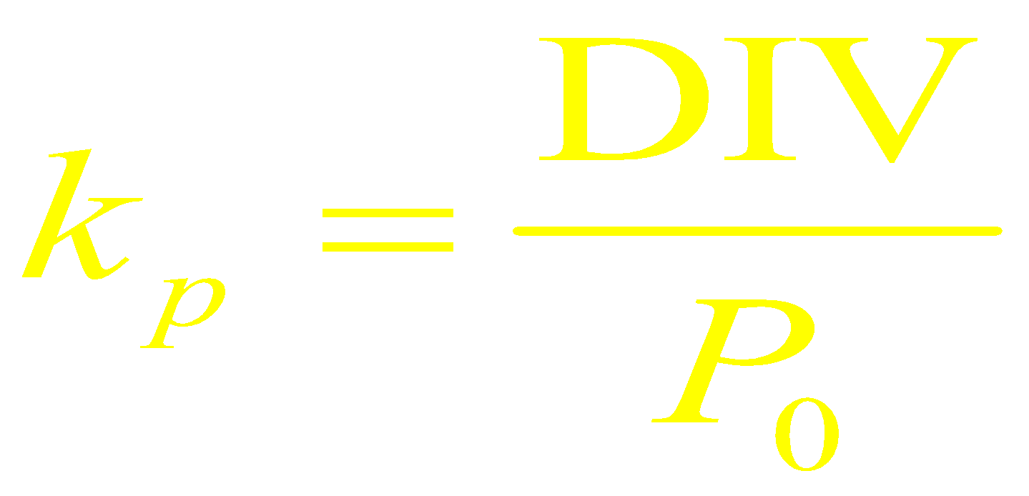
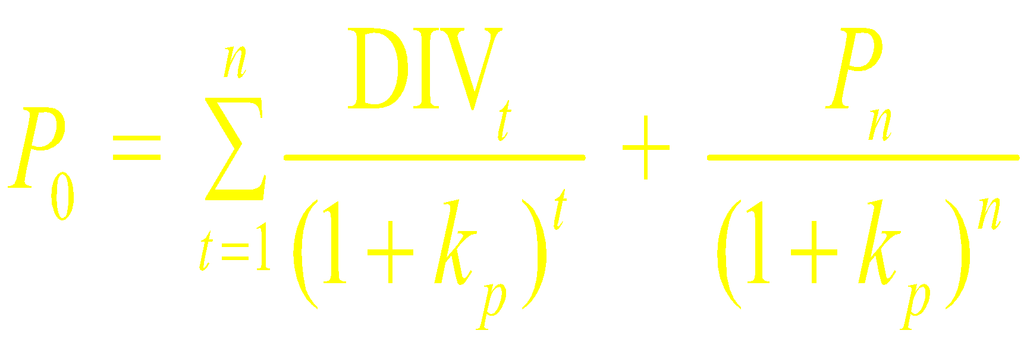
Cost of Preference Capital
Irredeemable Preference Share
Redeemable Preference Share

Slide 10
Cost of Equity Capital
Is Equity Capital Free of Cost? No, it has an opportunity cost.
Cost of equity (also known as cost of common stock) is the minimum rate of return which a company must generate in order to convince investors to invest in the company's common stock at its current market price. It is alternatively referred to as required rate of return.
Two approaches
Dividend Capitalization Approach
CAPM

Slide 11
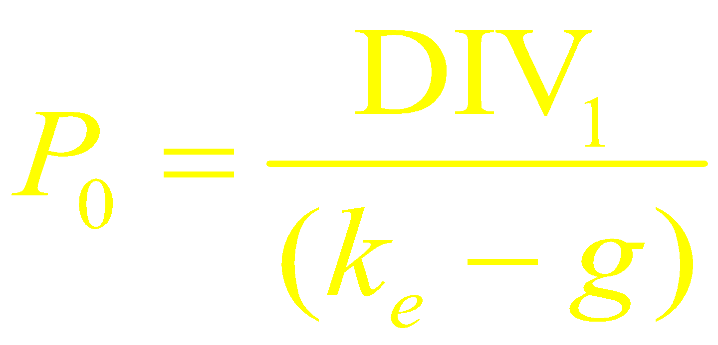
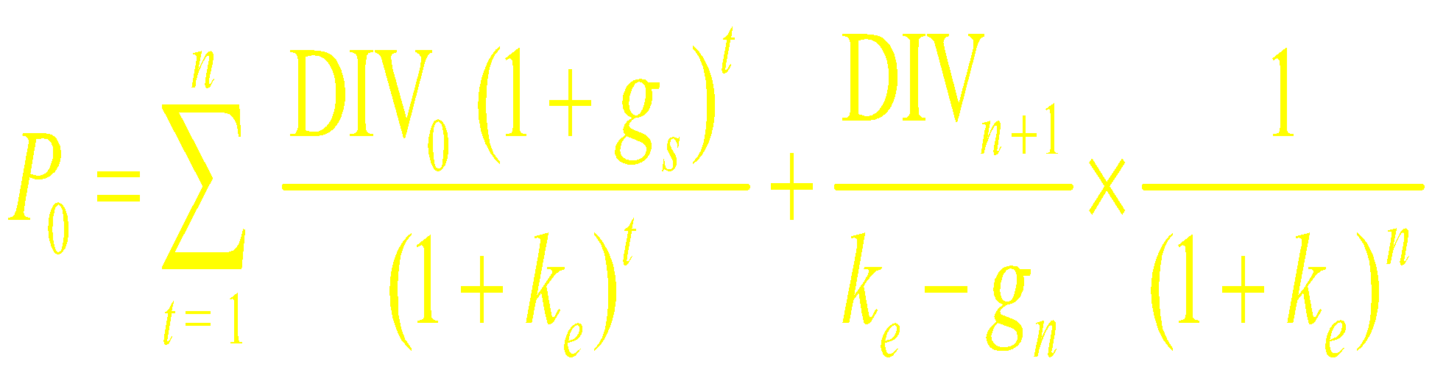
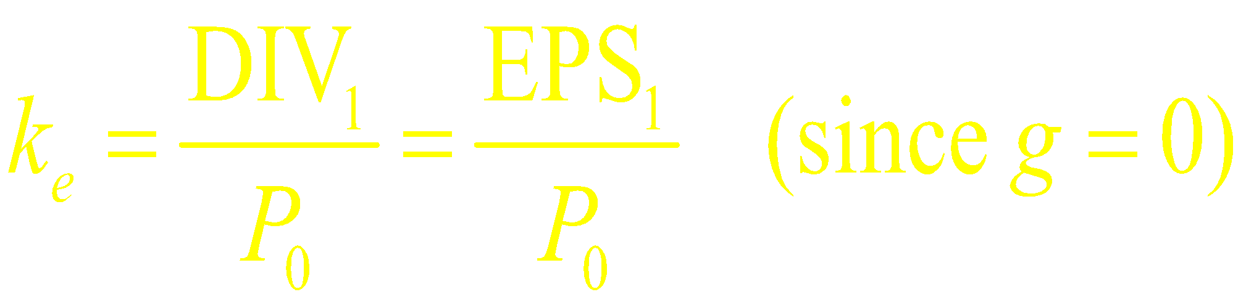
Cost of Equity
The Dividend—Growth Model
Normal growth
Supernormal growth
Zero-growth
Growth Rate (g) = (1 – Dividend Payout Ratio) * ROE

Slide 12
Cost of Equity
Praj Industry share price as at 30 December 2014 is INR 86.81 per share. Its last five year's average total dividends, return on equity and payout ratios are Rs.1.6, 34.75% and 47.08%.
Find out what would be the cost of Equity

Slide 13
Cost of Equty
Growth Rate: ( 1- Payout ratio) * ROE
Growth Rate = (1 − 47.08%) × 34.75% = 18.39%
Dividends in Next Period = Dividends in Current Period × (1 + Growth Rate) = INR1.6 × (1+18.39%) = INR 1.89
Cost of Equity = Dividend in Next Period/ Current Market Price + Growth Rate
Cost of Equity = INR 1.89 ÷ INR 86.81 + 18.39% = 20.57%

Slide 14
Dividend Capitalization Approach
Dividend per share of a firm is going to Rs. 1 and expected to grow at 6% per annum. If the market price is Rs. 25. Find cost of equity.
Cost of equity = (D₁/P₀) + g
=(1/25) + 0.06 = 0.04+0.06 = 0.10
XYZ Ltd. Is anticipating growth rate 12% for next 2 years, fall to 10% for the next 2 years, and 8% thereafter. The last dividend was Rs. 1.50. The current market price is Rs. 55. Find out Ke.

Slide 15
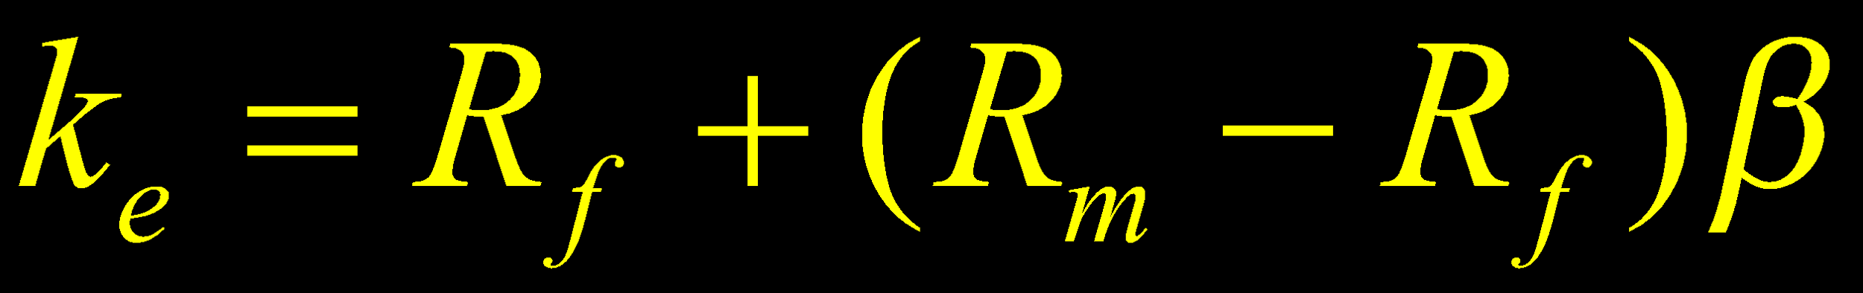
CAPM & Cost of Equity
As per the CAPM, the required rate of return on equity is given by the following relationship:
Equation requires the following three parameters to estimate a firm’s cost of equity:
The risk-free rate (R_{f})
The market risk premium (R_{m} – R_{f})
The beta of the firm’s share (β)

Slide 16
Cost of Retained Earnings
Is it free ?
The answer is “No”
Retained earnings have implied cost
It is marginally lesser than Ke
Floatation Cost of equity

Slide 17
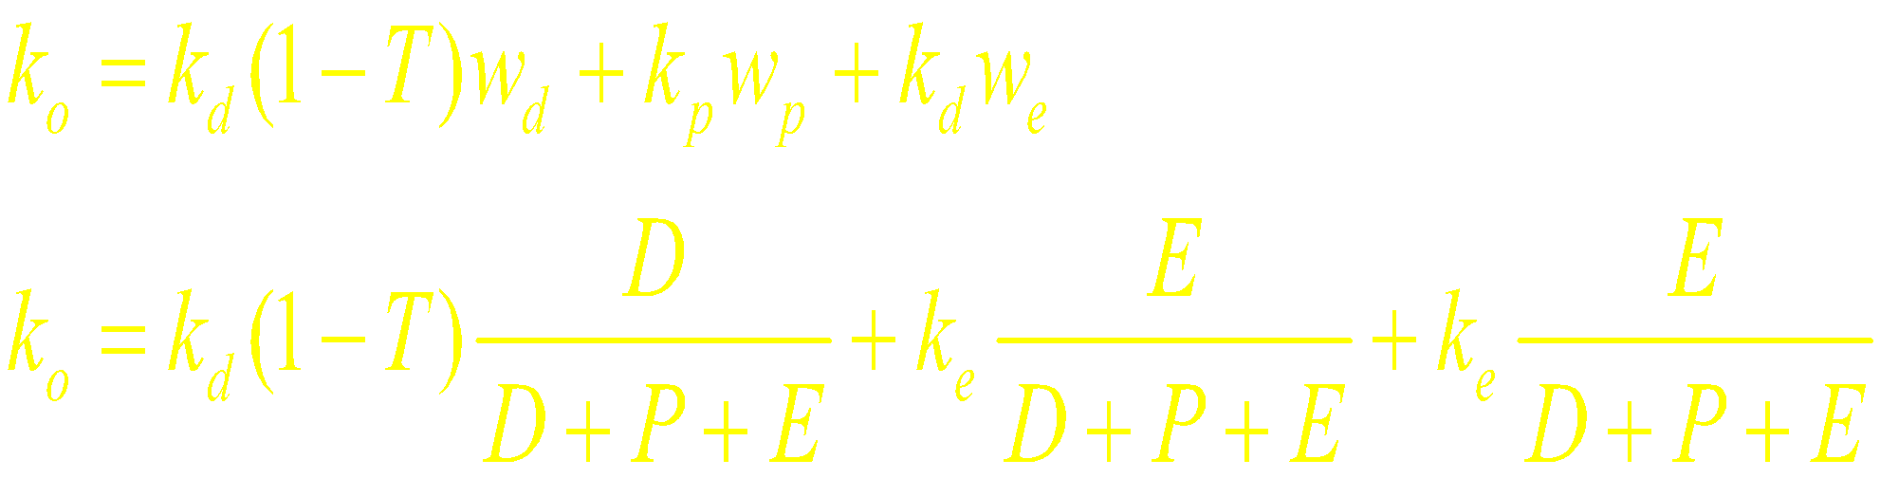
WACC
The following steps are involved for calculating the firm’s WACC:
Calculate the cost of specific sources of funds
Multiply the cost of each source by its proportion in the capital structure.
Add the weighted component costs to get the WACC.

Slide 18
Dividend Capitalization Method Vs. CAPM
The dividend-growth approach has limited application in practice
It assumes that the dividend per share will grow at a constant rate, g, forever.
The expected dividend growth rate, g, should be less than the cost of equity, k_{e}, to arrive at the simple growth formula.
The dividend–growth approach also fails to deal with risk directly.

Slide 19
CAPM
CAPM has a wider application although it is based on restrictive assumptions:
The only condition for its use is that the company’s share is quoted on the stock exchange.
Beta can differ substantially depending on the market index, price points ( daily vs. weekly , monthly)
One practical problem with the use of beta, however, is that it does not probably remain stable over time.

Slide 20
Weights
Managers prefer the book value weights for calculating WACC:
The book value information can be easily derived from the published sources.
The book value debt—equity ratios are analysed by investors to evaluate the risk of the firms in practice

Slide 21
Book Value Vs. Market Value
book-value weights can be seriously questioned on theoretical grounds:
First, the component costs are opportunity rates and are determined in the capital markets. The weights should also be market-determined.

Slide 22
Book Value Vs. Market Value
Market-value weights are theoretically superior to book-value weights:
They reflect economic values and are not influenced by accounting policies.
They are also consistent with the market-determined component costs.
The difficulty in using market-value weights:
The market prices of securities fluctuate widely and frequently.
A market value based target capital structure means that the amounts of debt and equity are continuously adjusted as the value of the firm changes.

Slide 23
WACC for New Projects
For new projects WACC is in fact the weighted marginal cost of capital (WMCC); that is, the weighted average cost of new capital given the firm’s target capital structure.
MCC is defined as cost of last rupee of new capital the firm raises and marginal cost raises as more and more new capital is raised during a period.

Slide 24
WACC for New Projects
The firm’s cost of capital will be the overall, or average, required rate of return on the aggregate of investment projects.
Can a firm’s WACC be used for all kinds of projects ?
If a firm is diversified, can WACC of the firm WACC be used ?

Slide 25
WACC for New Projects/Division
The project’s cost of capital is the minimum required rate of return on funds committed to the project, which depends on the riskiness of its cash flows

Slide 26
Divisional and Project Cost of Capital
A most commonly suggested method for calculating the required rate of return for a division (or project) is the pure-play technique.
The basic idea is to use the beta of the comparable firms, called pure-play firms, in the same industry or line of business as a proxy for the beta of the division or the project.

Slide 27
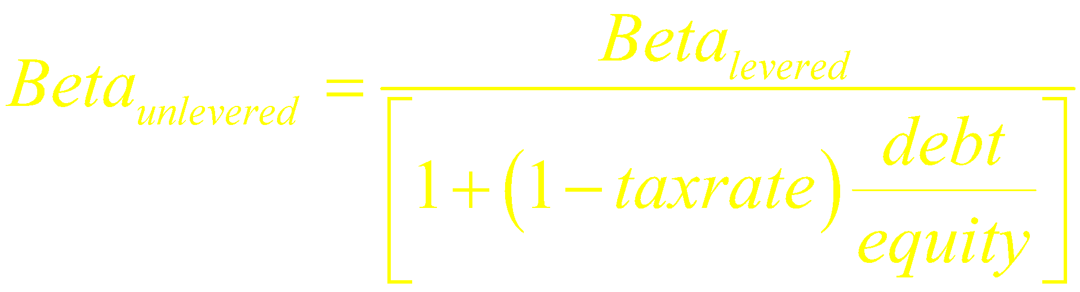
Comparable Firms
Identified through
Matching line of business
Matching sales
Estimate the equity beta (levered beta)
Estimate the unlevered beta (asset beta) for comparable firms.
Estimate the business beta/unlevered industry beta

Slide 28

Comparable Firms

Slide 29
Comparable Firms
Calculate the division’s business beta
First calculate the unlevered/asset beta
Calculate business beta
Comparable Firms | Sales | Assets | Debt | Equity | Fixed/Variable Cost | Equity Beta (CAPM) | Asset Beta | Business Beta
ABC | 1000 | 650 | 325 | 645 | 0.28 | 1.24 | 0.82 | 0.64
KLM | 800 | 700 | 180 | 700 | 0.14 | 0.94 | 0.75 | 0.65
PQR | 1400 | 1250 | 625 | 750 | 0.3 | 1.05 | 0.55 | 0.42

Slide 30
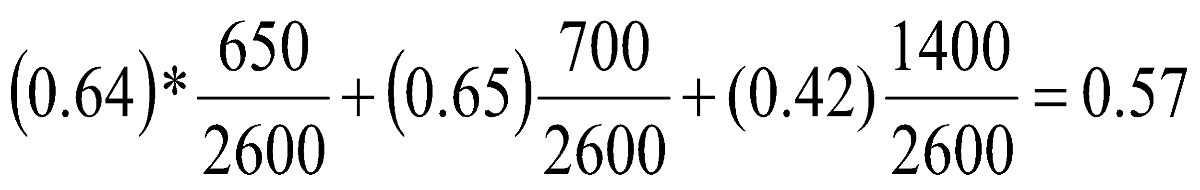
Divisions business beta
Simple /Weighted average of business betas with weights of sales/assets
Business beta of division ( assets of comparable firm as weights)
Find out the unleveraged beta of the division keeping in mind fixed/variable operating cost
Find out the leverage beta keeping in mind the target capital structure of the new project/division

Slide 31
Divisions Levered/equity Beta
Suppose the company wants to maintain D/E ratio of 20/80. Fixed to variable cost is 0.42.Tax rate is 33%
Find out unleveraged and leveraged beta from the industry beta.
For example, Divisions levered beta = 0.95
Divisions cost of equity = Rf + beta ( Rm-Rf)
Ke = 15%
Calculate WACC for the project/division

Slide 32
WMCC( Weighted Marginal cost of Capital
WACC associated with the next dollar of total new financing.
Costs of financing components ( debt, preference shares, & equity shares) rise as as larger amounts are raised.

Slide 33
Cost of Capital for Projects
Adjusted WACC = WACC +- R
R is the risk adjustment factor
Companies identify projects with
Low risk
Medium risk
High risk

